Slide 1
Case Study
Managing Aeration Energy Usage
(Analyzing BOD load removal per kilowatt hour)

Slide 2
Problem: Energy Costs Must Be Reduced
Problem:
Oxygen transfer efficiency is a function of bubble size. The smaller the bubble, the higher the efficiency. Ceramic or membrane diffusers will foul in time, causing the bubble size to increase which uses more energy to treat the same BOD load. To minimize energy used with minimal downtime, it is important to determine when diffusers need to be cleaned.
Symptoms:
Monthly energy bill increasing, over budget year to date
Aeration basin efficiency is down
Inefficient cleaning cycles adding cost
Notes:
2

Slide 3
Plan: Analyzing the problem
The principles of “Plan-Do-Check-Act” provide sustainable results.
Plan: Use WIMS to compare pounds of BOD removed (lab data generated from the Hach HQ430D Benchtop meter with the Intellical LBOD probe) per KW of electricity used (SCADA data)
“"The Hach WIMS™ has been instrumental in the collection of relevant data. Its data capture and reporting capabilities have provided us a comprehensive analysis of our projects.”
Hach WIMS has fostered analysis beyond regulatory data. Information on pumping stations, energy usage, material usage, and cost analysis are just a few of the trends performed to enhance optimization.”

Slide 4
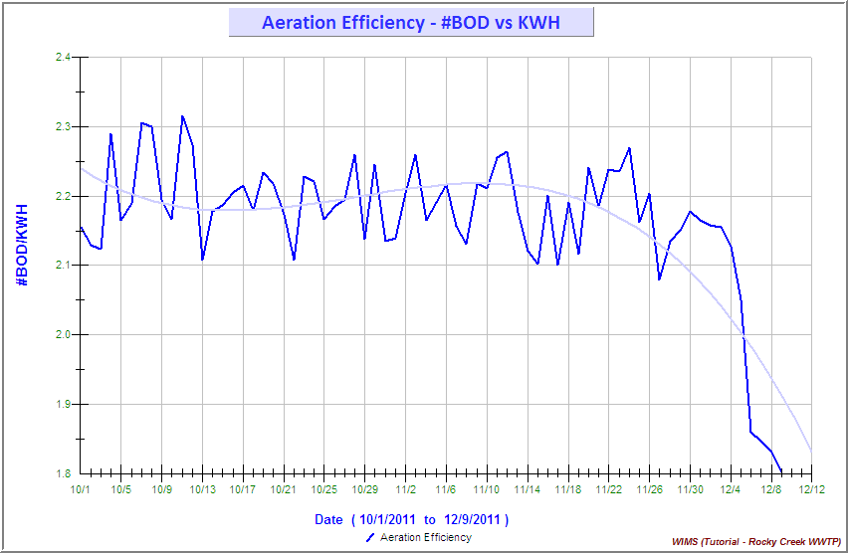
Do: Identify the Problem
WIMS™ shows the cleaning cycle by benchmarking pounds of BOD removed (lab data) per KW of electricity used (SCADA data). Benchmark shows that the diffuser should be cleaned at 2.0lb BOD/kwh
Diffuser Cleaning Recommended
Notes:
4

Slide 5
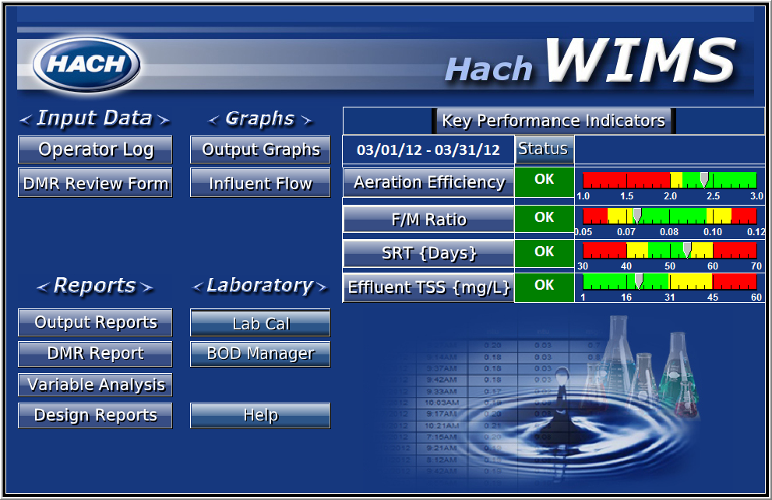
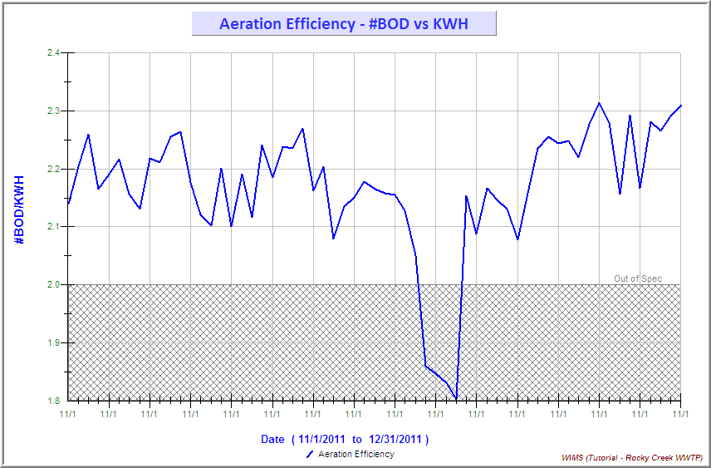
Check: Sustainability
Best Management Practices say it is not enough to simply identify the problem and formulate a solution. The solution must be sustainable to gain maximum benefit.
Sustainability:
Continuous monitoring and improvement
via dashboards and email notification
Making data-driven decisions
Open communications
Monitoring becomes easy
Useful graphs are one click away
Notes:
5

Slide 6
Act: Results and Continuous Improvement
Savings Achieved:
Optimized cleaning cycle saves approximately 30% to 50% energy costs
Improved diffuser maintenance and prolonged asset life
More efficient maintenance lowering maintenance cost
Management by exception
Dashboards allow easy monitoring for sustainability
Monitoring Key Performance Indicators provides early warning and allows time for efficient planning
Making Data-Driven Decisions
Remove BOD at designed capacity to ensure regulatory compliance
Data shows optimal cleaning cycles
Data used to communicate more effectively
Notes:
6

